Slide 1
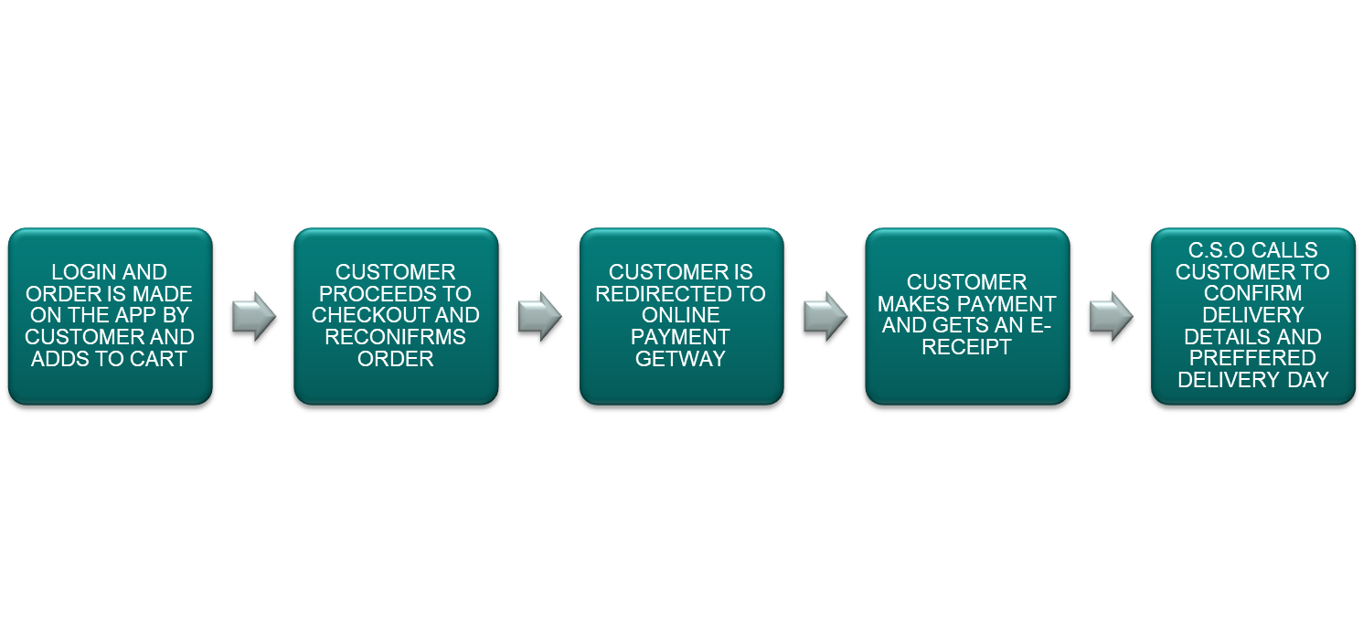
PROCESS WORKFLOW FOR ORDERS ON THE APP

